Slide 1
Smart Platforms
Software Architecture and Scalability for Internet of Things
Kevin Lee
Notes:
Accessibility requirements for template users
This PowerPoint template has been created with a number of in-built accessibility options.
When working with this template, there are a few things you will need to do within the file to ensure that it meets Deakin’s accessibility requirements when documents, or exported pdf files, are shared with others or placed online.
Font styles
Only use the provided heading styles and text styles as pre-set in the template
ALT text
All images and graphics, backgrounds, logo and brand shapes need to have ALT text added to describe the image or be indicated as decorative. Elements provided within the template have had this added, but if you make any changes or add your own images/replace any default imagery, you will need to ensure ALT text is added.
If an image is also a hyperlink provide the destination in writing, for example an image of a ‘Hand holding a pen writing in a notebook’ that hyperlinks to Deakin homepage should also explain that the link goes to that page.
ALT text can be added by right clicking on the image/graphic and selecting ‘Edit alt text’ from the window.
Tables
All tables are required to include alt text.
The first row in a Word table can be identified as a header row/table title which can help screen reader users identify what the table content is about and whether they want to read it.
Where tables are already included, a basic form of ALT text will have been added, but you will need to add your own by going into the ‘table properties’ for each table, and clicking on the’ Alt text’ tab, and then completing the fields to provide a suitable description of your content.
Accessibility checker
Word has an inbuilt accessibility checker which can help to flag issues – go to ‘Review > Check accessibility’ in the toolbars.
Saving as a pdf
When saving your file as a pdf, note that using the ‘Print to PDF’ option doesn’t keep any inbuilt accessibility features. Instead use the ‘Save As > PDF’ option, and check that “Document structure tags for accessibility” is selected

Slide 2
The IoT Loop!
Think
Environment
Act
Sense
Deakin University CRICOS Provider Code: 00113B

Slide 3
The IoT Loop!
The sensing components (wearables, mobiles, …) collect data from the managed environment
The thinking component(s), analyse the data, update the environment model, and may take decisions to change the state of the world (environment)
The actuation components, where decisions are put to action to effect changes on the environment.
Deakin University CRICOS Provider Code: 00113B

Slide 4

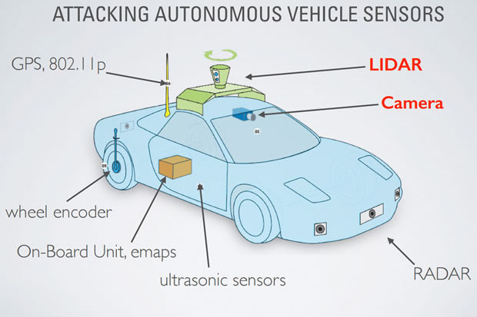

The IoT Loop!
Sense
Think
Act
Environment
Deakin University CRICOS Provider Code: 00113B

Slide 5
Why Thinking? Problems with the current sensing capabilities
Sensors do not capture everything in a given environment or a monitored object.
Sensors only measure and produce raw data - e.g. temperature, motion, heart rate, etc. that we have to further process to understand the environment
Usually, we do not see or have access to the actual environment. Thus, we do not know the ground truth -- what is actually happening in the environment.
We need to better understand the context -- going from the bit and bytes we collect from the sensors to clear understanding of what is happening in the environment.
Deakin University CRICOS Provider Code: 00113B

Slide 6
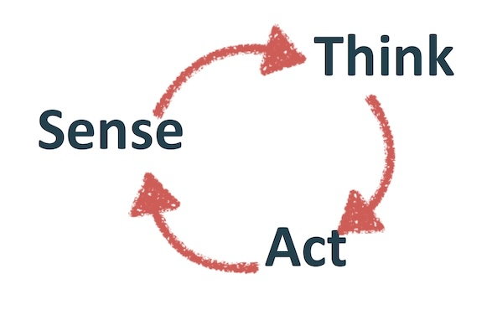
Smart Platforms for IoT
All IoT Smart Platforms must enable:
1 - the collection of data
2 - Some processing/filtering/aggregation or the data
2 - the eventual actuation of an event (else it would just be a sensor network)
6

Slide 7
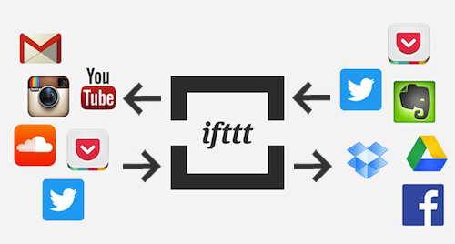
Examples: Rules Engine - IFTTT
Rules engine: It is usually easy to write rules, but can also get complicated -- e.g. IFTTT.
Rules are useful when we do not have data to learn from
https://ifttt.com/
Deakin University CRICOS Provider Code: 00113B

Slide 8
Examples: Rules Engine - IFTTT
Rules can also be used for activity recognition, BUT sensors are not accurate, and scenarios could keep increasing in complexity
IF kitchen_motion == ACTIVE THEN
IF kitchen_motion == ACTIVE &&
duration > 3 minutes &&
time > WAKEUP_TIME THEN
kitchen_occupied = true
play(morning_greeting)
kitchen_occupied = true
play(morning_greeting)
IF kitchen_motion == ACTIVE &&
duration > 3 minutes THEN
IF kitchen_motion == ACTIVE &&
duration > 3 minutes &&
time > WAKEUP_TIME &&
first_greeting == true THEN
kitchen_occupied = true
play(morning_greeting)
kitchen_occupied = true
play(morning_greeting)
Deakin University CRICOS Provider Code: 00113B

Slide 9
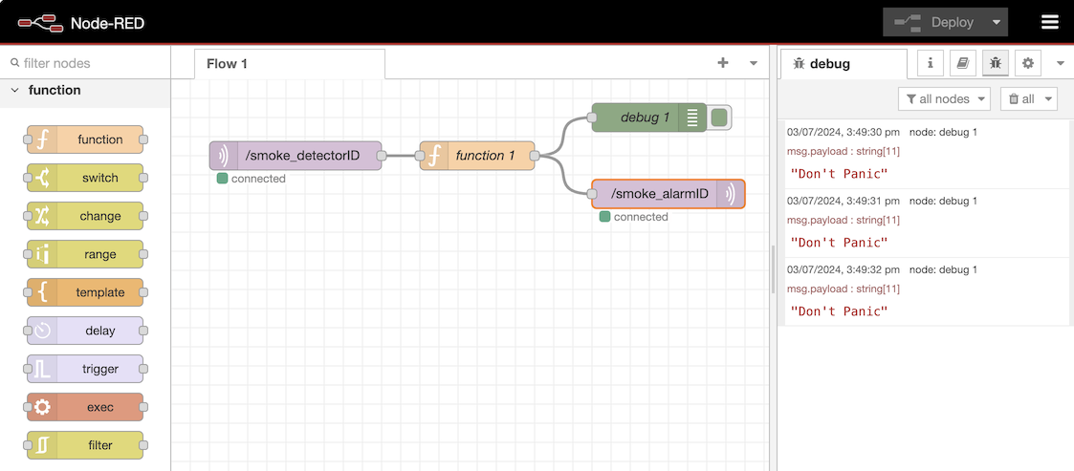
Examples: Flow constructor – Node-RED
Low Code approaches to building IoT flows
Visually connect inputs, processes and outputs
Based on Node.JS
Support MQTT input/output
Can be quickly spun up in lots of locations
Deakin University CRICOS Provider Code: 00113B

Slide 10



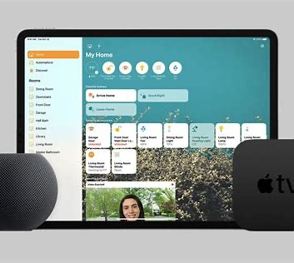

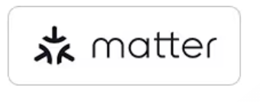
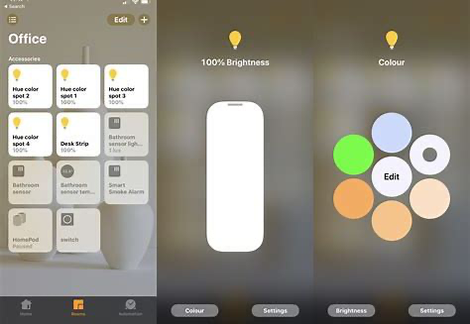

Examples: Home integration platforms
Samsung SmartThings, Apple HomeKit, Google Home
Platforms that allow the inter-connection of many devices from different companies
Focused on single home setups
Allows users to build simple control panels
Focused on controlling lights, Heating/Cooling, energy, cameras
Capability to build simple triggers and workflows
Connectivity with AI Assistants
Based on some proprietary technology and some open standards
Deakin University CRICOS Provider Code: 00113B

Slide 11
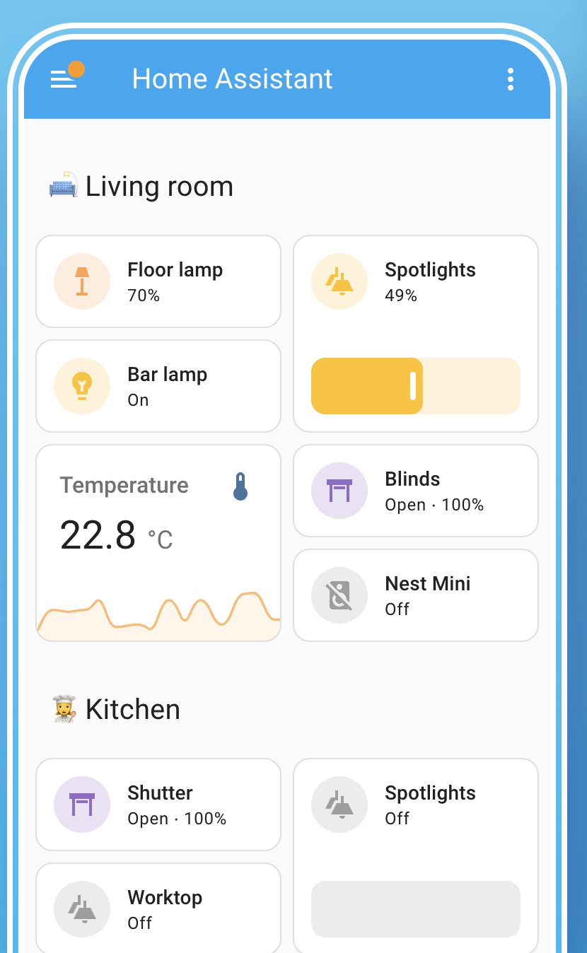

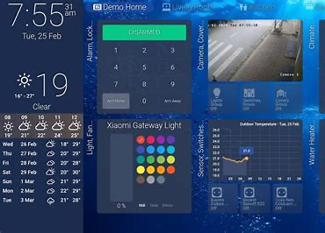


Examples: Home integration platforms (Open Source)
Home Assistant
Powerful open-source community project
Aims to replace/compete with the commercial offerings
Ability to build custom interfaces
Highly scalable, many users, many devices, multiple views
Tight integration with other open-source projects
Integration with open-source voice and AI assistants
There are others, but Home Assistant is by far the most mature.
Deakin University CRICOS Provider Code: 00113B

Slide 12


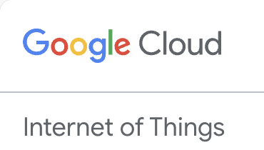
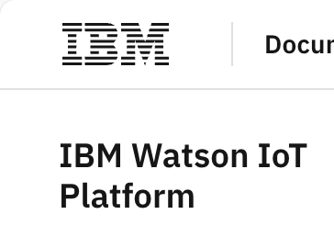
Examples: PaaS development platforms
AWS IoT Core, Azure IoT Central, Google Cloud
Commercial and proprietary platforms
Ready to go communication stack and UI
Powerful management interfaces
Connectivity management, security, user management
Plugs into existing cloud and development platforms
Development and deployment support ecosystems
High cost
Deakin University CRICOS Provider Code: 00113B

